Slide 1

Welcome to AI World

Slide 2


What is AI?
Artificial Intelligence (AI) is a branch of computer science that focuses on creating systems capable of performing tasks that typically require human intelligence. These tasks include learning, reasoning, problem-solving, perception, and language understanding

Slide 3
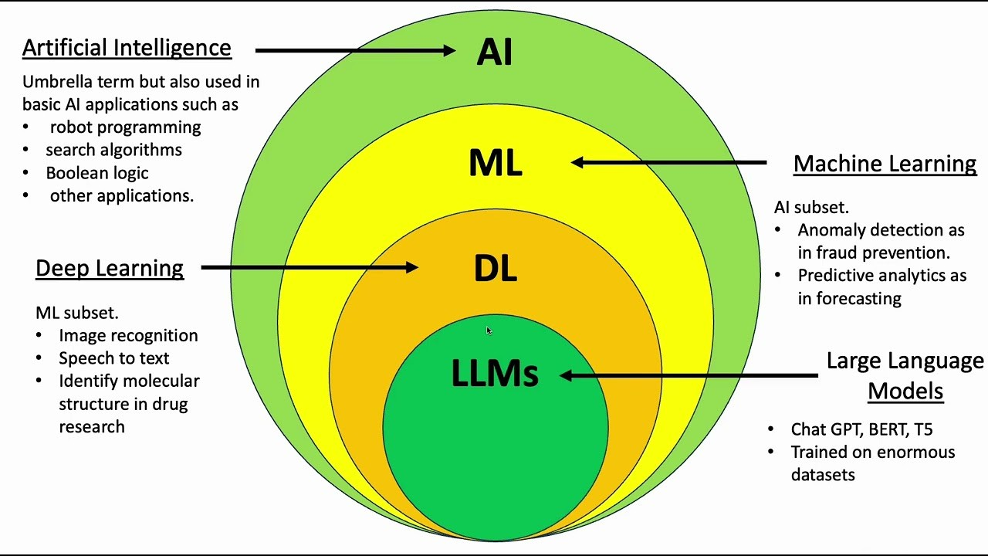

Slide 4
What is machine learning (ML)?
Machine learning (ML) is defined as a discipline of artificial intelligence (AI) that provides machines the ability to automatically learn from data and past experiences to identify patterns and make predictions with minimal human intervention.

Slide 5
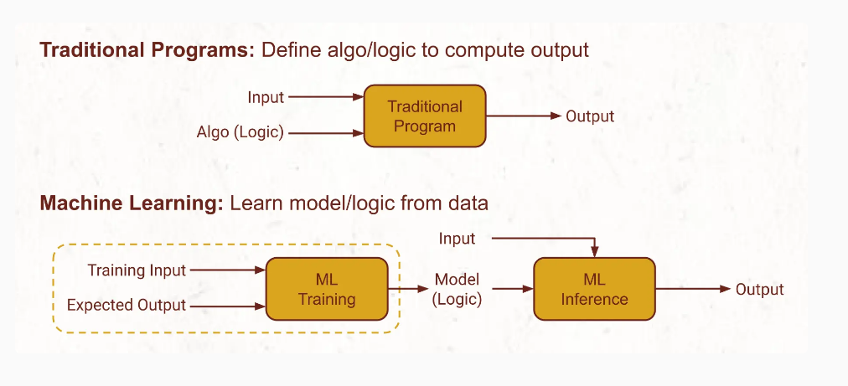
Traditional Programs vs. Machine Learning

Slide 6
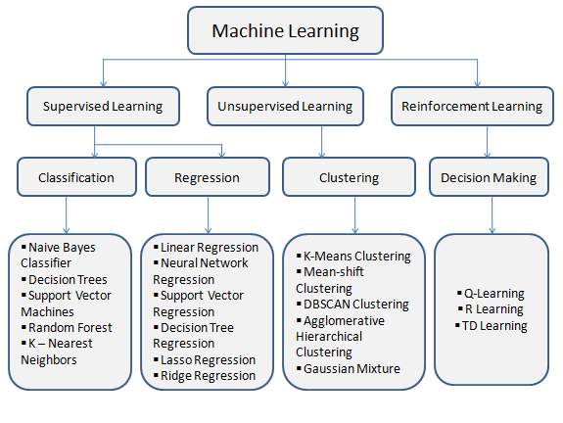
Types of machine learning

Slide 7
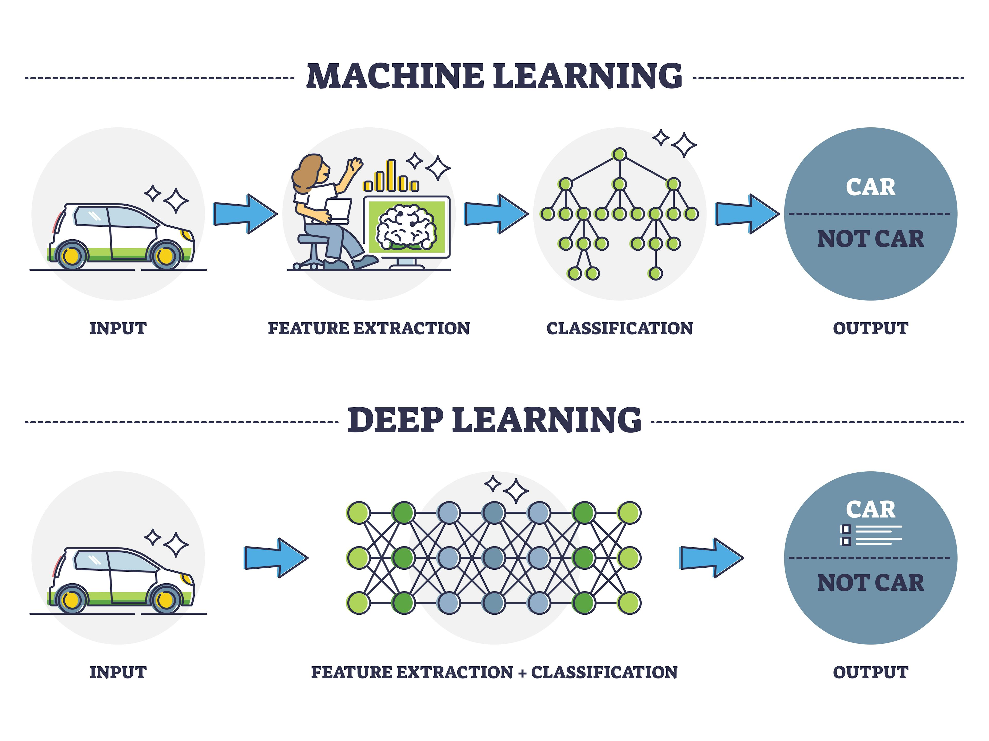
What is DEEP learning (DL)?
Its multilayered neural networks, called Deep neural networks, to simulate the complex decision-making power of the human brain intervention.

Slide 8
What is Natural Language Processing?
Natural language processing (NLP) is a field of computer science and a subfield of artificial intelligence that aims to make computers understand human language.

Slide 9
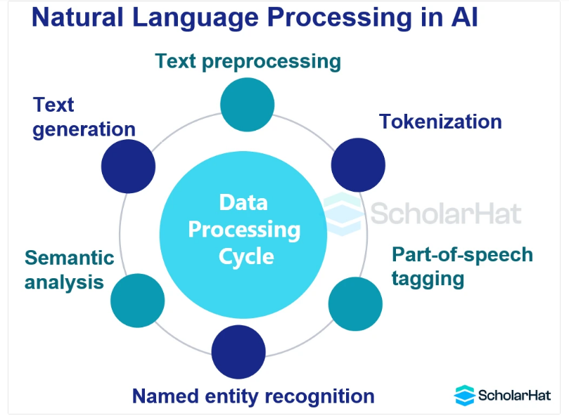

Slide 10
What is a large language model (LLM)?
A large language model (LLM) is a type of artificial intelligence (AI) program that can recognize and generate text, among other tasks. LLMs are trained on huge sets of data — hence the name "large."
This pretrained LLM models are called as Foundational model
LLMs are built on machine learning: specifically, a type of neural network called a transformer model.

Slide 11
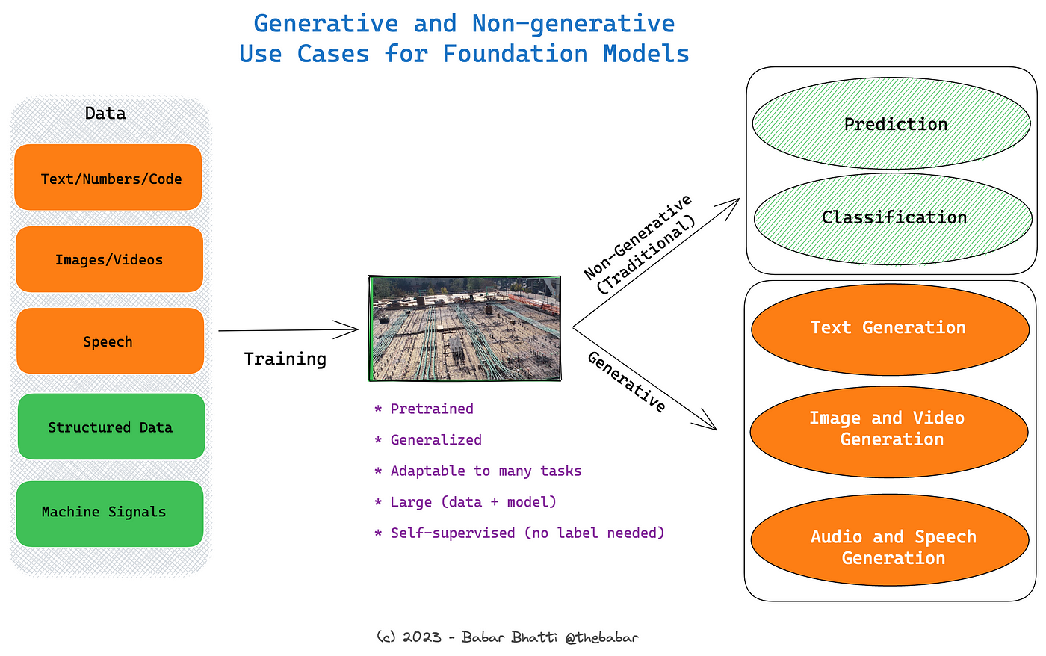

Slide 12
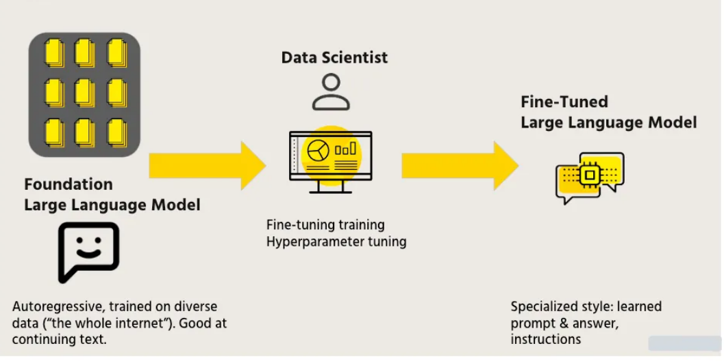

Slide 13
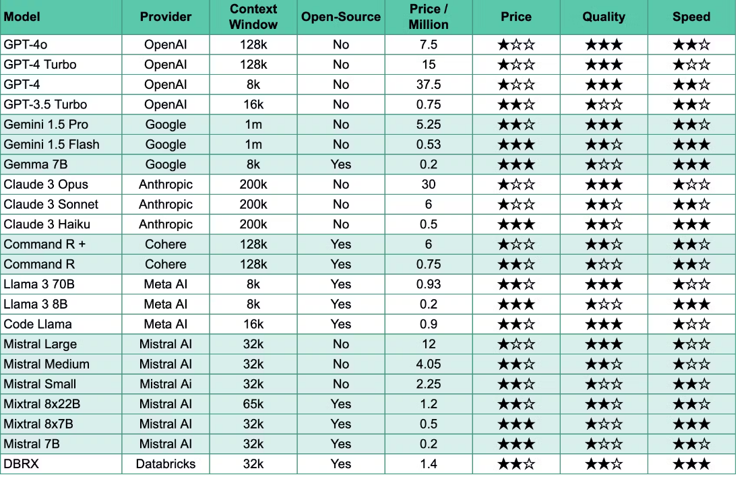
Leading Large Language Models:

Slide 14
The limitations of LLM’s
Despite powerful capabilities with many tasks, Large Language Models (LLMs) are not know-it-alls.
If you've used ChatGPT or other models, you'll have experienced how they can’t reasonably answer questions about proprietary information.
It will provide hallucinated response
That's where options like Fine Tuning or Retrieval Augmented Generation (RAG) come in and give LLMs the ability to incorporate new and proprietary information into their answers.

Slide 15
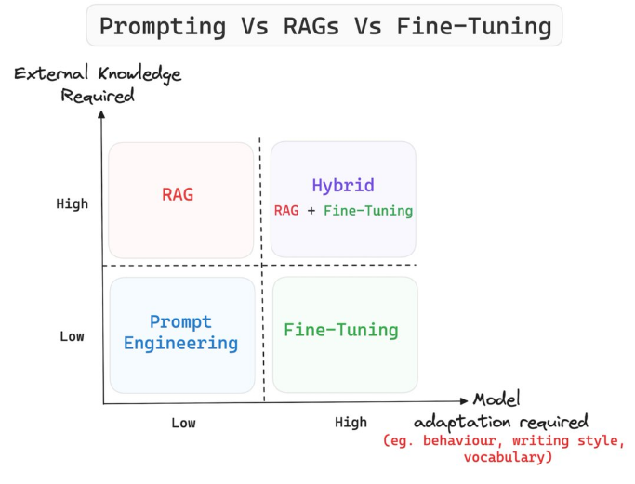
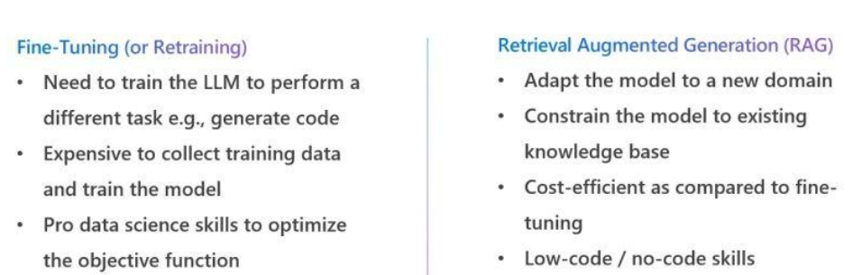
Prompting vs RAG VS Fine Tuning

Slide 16
Retrieval-Augmented Generation (RAG)
RAG is an AI framework that combines the strengths of traditional information retrieval systems (such as databases) with the capabilities of generative large language models (LLMs).
By combining this extra knowledge with its own language skills, the AI can write text that is more accurate, up-to-date, and relevant to your specific needs.
The vector search is one option for retrieving relevant proprietary documents for RAG to operate
It aims to find semantically similar vectors by calculating the proximity of different vectors to each other,

Slide 17
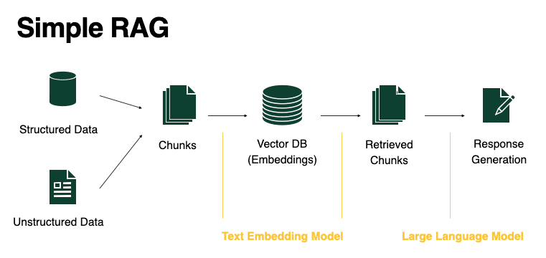

Slide 18
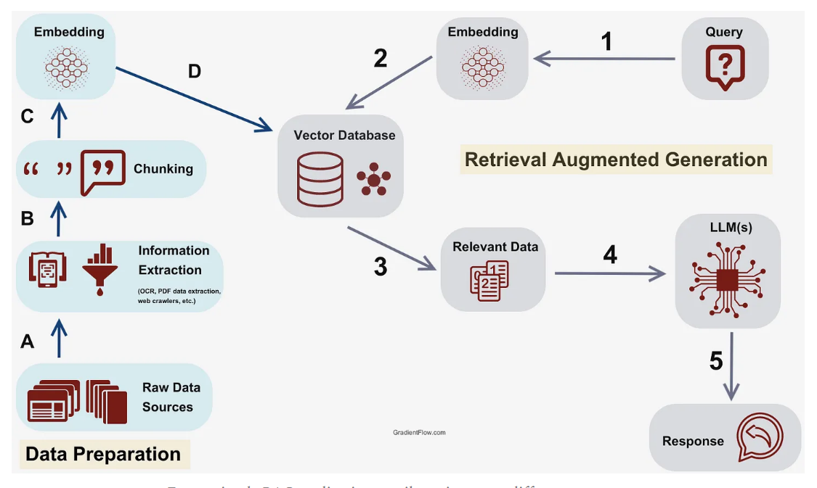
Simple RAG

Slide 19
Thank you
Q&A….

